Slide 1
Kidney A1
Meeting minutes &
Action point slides
Date: 08/05/2022 (Week 10)

Slide 2
Progress and action points
Key progress over last week …
Created Flow Chart
Refined feature selection process using CV
Introduced Weighted Logistic Regression to decrease the weight of top genes
Fairness and Stability analysis
Refined Volcano plot

Slide 3
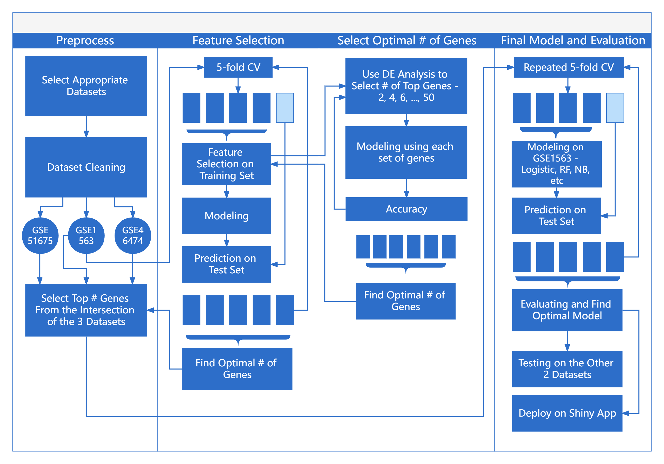
Figure 1: Schematic of the Project overview

Slide 4
Meeting minutes
Date and time of meeting: 2022/05/08
Team members present: Qinlin Gu, Danying Sun, Xuening Ni, Hangyi Wu
AGENDA
Item | Discussion (you can refer to previous slides) | Actions (who) – action points for next week
 |  | Begin to build a scaffold for the Shiny app and the report
Next meeting date and time: 2022/05/09
Group member responsible for finalising/submitting minutes: Qinlin Gu
To be posted on the CANVAS Individual group website

